Slide 1
RISC-V Tutorial
Zhiming Zhang

Slide 2
Outline
Verilator simulation
Hello world!
Spectre V1 example
Configure your own BOOM -- SSE-RV example
Cycle-by-cycle debugging
FPGA emulation
Original BOOM SoC
SSE-RV BOOM SoC
General Vivado design chain
Vivado integrated logic analyzer (ILA)
New microarchitectural attack replications on SonicBOOM
Backend: FDiv covert channel
Frontend: Spectre V4
Improvement of SSE-RV
Overtainting issue
Overuntainting issue
Extended SSE-RV

Slide 3
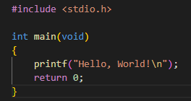

Verilator Simulation
Hello world!
Follow https://chipyard.readthedocs.io/en/latest/Chipyard-Basics/Initial-Repo-Setup.html#initial-repository-setup to setup the Chipyard environment to run Verilator
Compile a SmallBoomConfig on Verilator
Go to chipyard/sims/verilator, then
Create a hello.c
Compile hello.c using the riscv64-unknown-elf-gcc in chipyard/riscv-tools-install/bin
Run Verilator
1)
2)

Slide 4
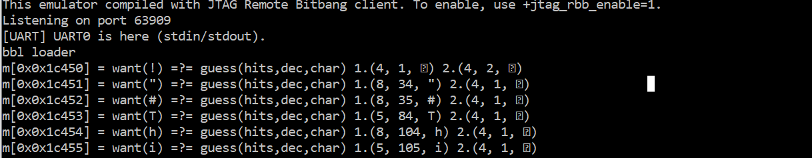
Verilator Simulation
Spectre V1 attack example
Understand the Spectre V1 code in https://github.com/sabbaghm/boom-attacks
Compile Spectre V1
Perform Spectre V1 attack on SonicBOOM
Secret retrieving!

Slide 5
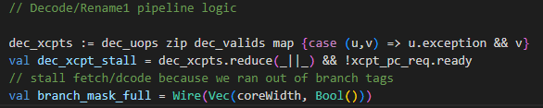
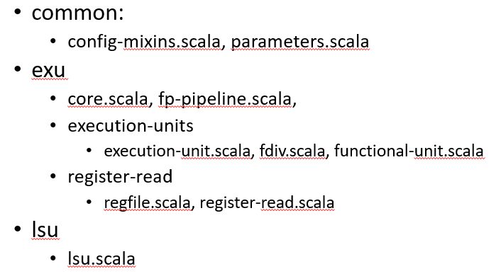
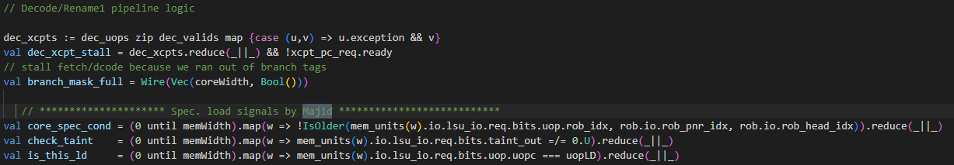
Verilator Simulation
Configure your own BOOM -- SSE-RV example
Find the SSE-RV protected BOOM core in Sequoia server /home/majid/unified_MajidSabbagh_PhD under SSE-RV/SonicBoom
Go to chipyard/generators/boom/src/main/scala
Modify the Chisel source codes based on SSE-RV BOOM core
Involved files
Original:
SSE-RV:

Slide 6
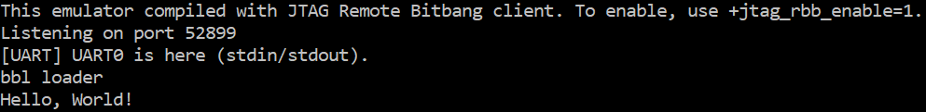
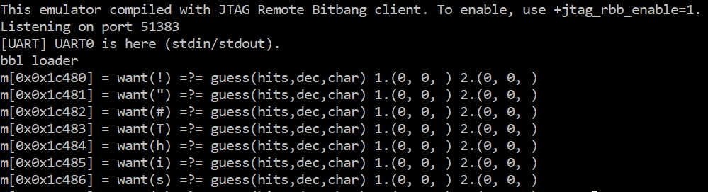
Verilator Simulation
Configure your own BOOM -- SSE-RV example
Source env.sh and compile a SmallBoomConfig
Test SSE-RV, you should see
Hello world runs correctly
Spectre V1 is mitigated
Leaking is prevented!

Slide 7
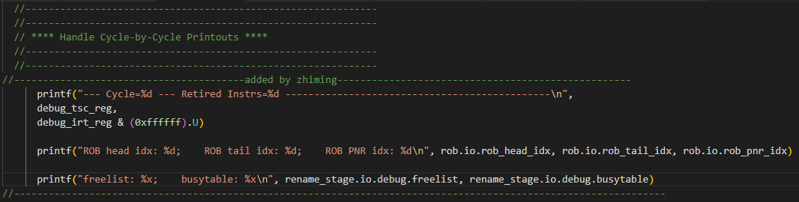
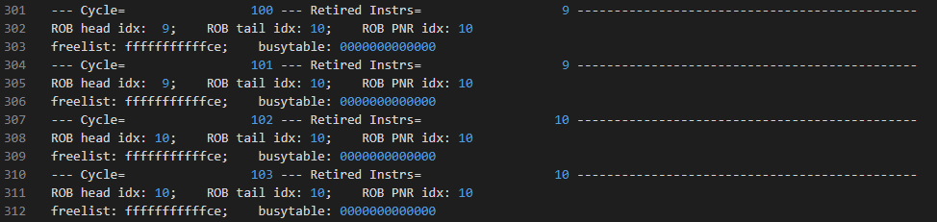
Verilator Simulation
Debug example -- cycle-by-cycle log
In core.scala, add the following printfs to the Handle Cycle-by-Cycle Printouts section
Compile a SmallBoomConfig with debug enabled
Simulate hello world using the newly configured simulator-chipyard-SmallBoomConfig-debug
hello.log:

Slide 8
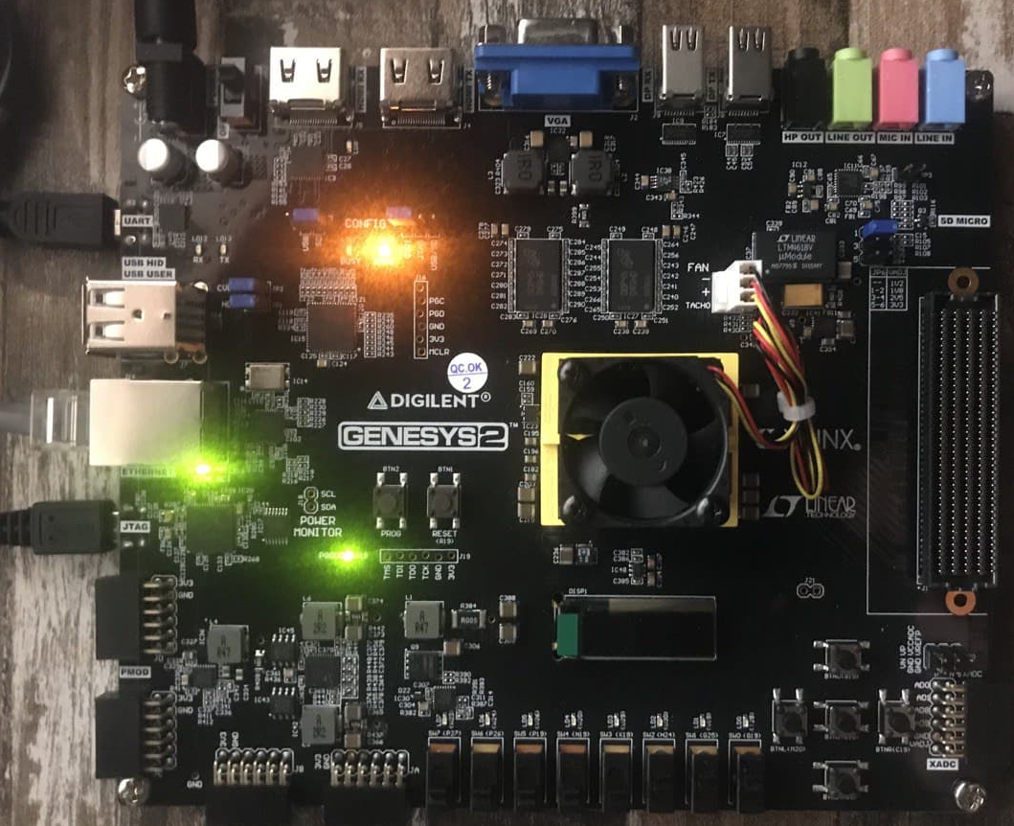
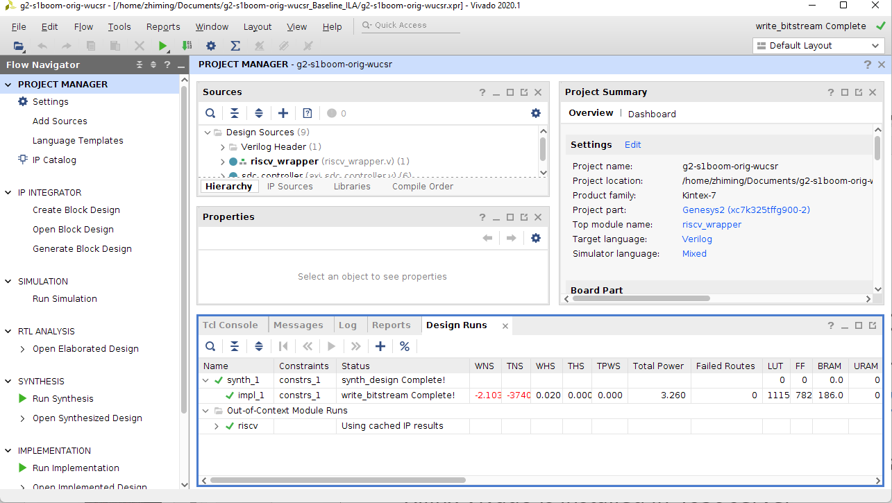
Original BOOM SoC
Find the Xilinx Genesys-2 FPGA board in ISEC room463c
Power up the board and connect both USB and UART ports with a computer
Go to https://github.com/eugene-tarassov/vivado-risc-v and follow the steps to program Genesys-2 with original BOOM-based SoC
You can skip “Prepare the SD card” since there is already a card prepared
Xilinx Vivado is installed in 463c server

Slide 9
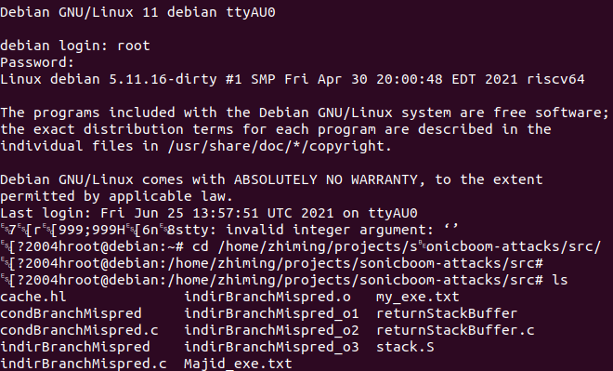
Original BOOM SoC
Login to the Debian system running on the FPGA board
Through UART: sudo miniterm /dev/ttyUSB* 115200
Through SSH: ssh debian@ipFPGA or ssh root@ipFPGA
Username/password: debian/debian or root/root
Uart transmission may bring in weird symbols but that is only a display issue
Hello world!
Create a hello world c code on Debian
Compile it using gcc and run the compiled executable
Run Spectre attacks on FPGA
The FPGA-version of Spectre attacks are slightly different from the Verilator-version and can be found at: https://github.com/sabbaghm/sonicboom-attacks

Slide 10
SSE-RV BOOM SoC
In the newly cloned vivado-risc-v repo, locate the BOOM generator at vivado-risc-v/generators/riscv-boom
Modify the Chisel source codes towards SSE-RV (Same as what we did in Verilator simulation)
Regenerate bitstream
source /opt/Xilinx/Vivado/2020.1/settings64.sh
make CONFIG=rocket64w1 BOARD=genesys2 bitstream
Program FPGA and boot the system (no need to reprepare SD card)
Perform Spectre attacks again to see if leakage is mitigated

Slide 11
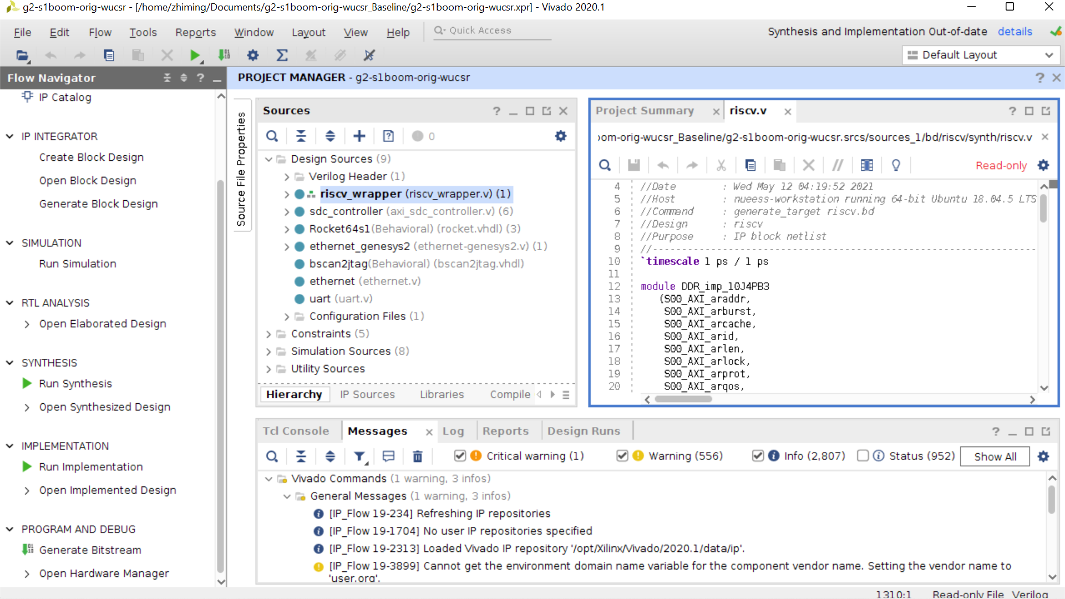
Vivado General Design Chain
Source hierarchy
Source file editing
Main design flow
Check errors, warnings, infos, …

Slide 12
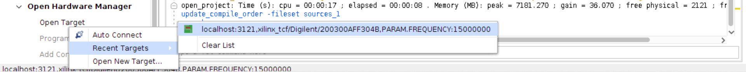
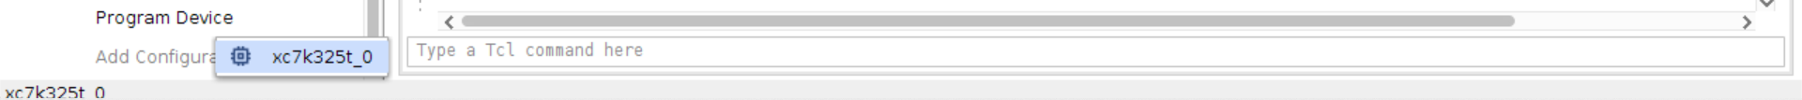
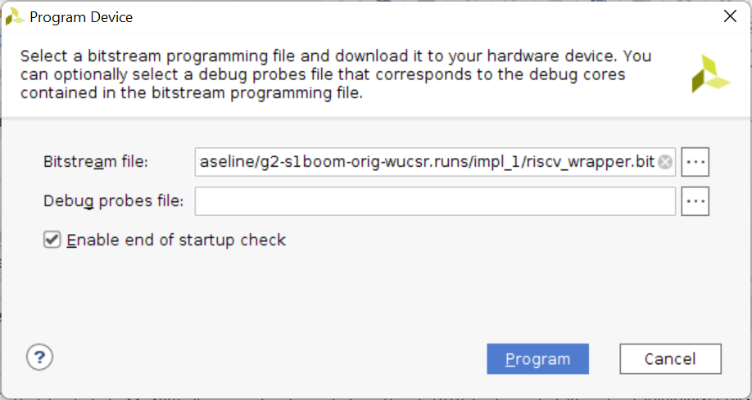
Vivado General Design Chain
To generate bitstream
Run Synthesis → Run Implementation → Generate Bitstream
To program FPGA
Go to Open Hardware Manger → Open Target
Click on Program Device
Make sure the bitstream is correct, then click Program

Slide 13
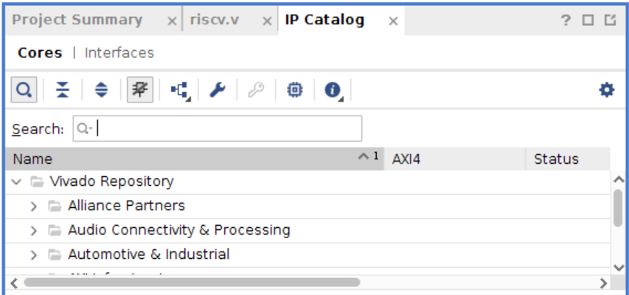

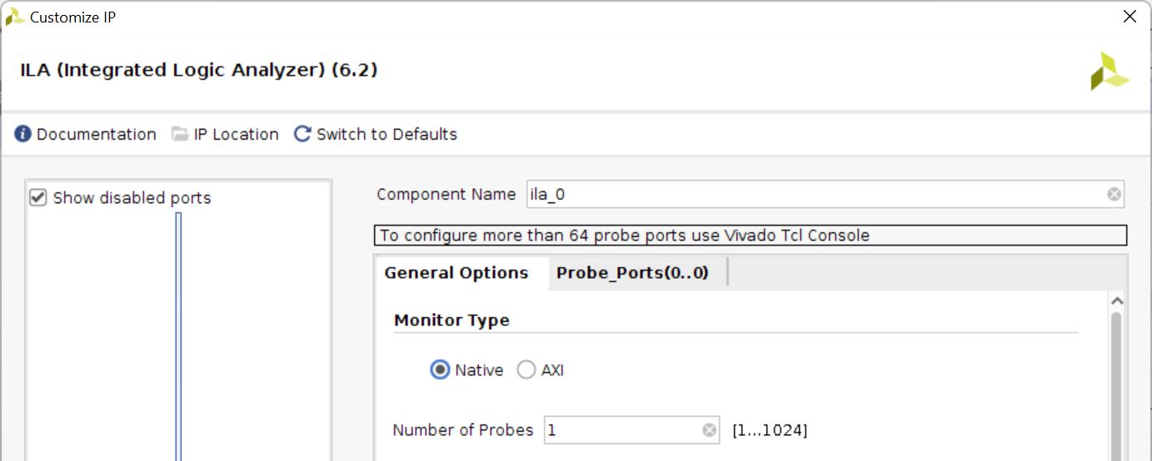
Integrated Logic Analyzer (ILA)
We can use Vivado ILA to help debugging FPGA design
Click on the left-hand side of Vivado GUI
An IP Catalog subwindow is then added to the source editing area
Go to → →
A Customize IP window will show up

Slide 14

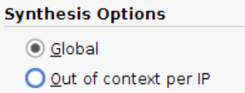

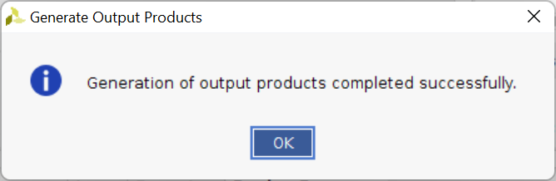
Integrated Logic Analyzer (ILA)
In the Customize IP window
Set up the Number of Probes
Check Advanced Trigger
Set up the width of each probe
Click OK
In the following Generate Output Products window
Choose Synthesis Options as Global
Click Generate, the ILA module is then added to Design Sources

Slide 15
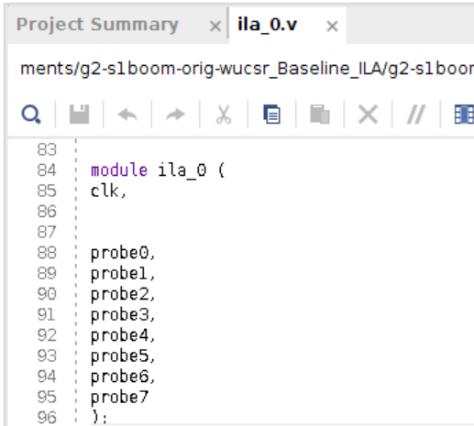
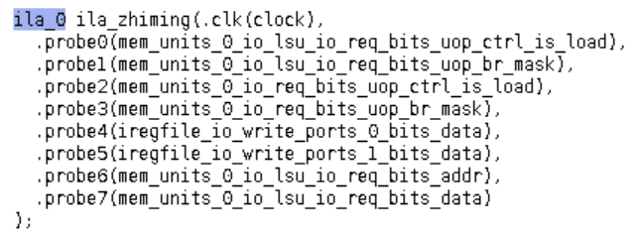
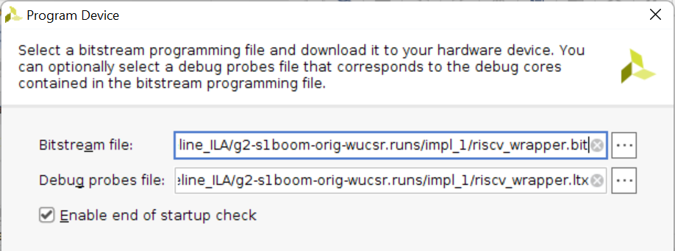
Integrated Logic Analyzer (ILA)
Check the Verilog file of ILA module and instantiate it by conducting the ports
Rerun the design flow to generate a new bitstream
When programming the FPGA, a new Debug probes file is also included

Slide 16
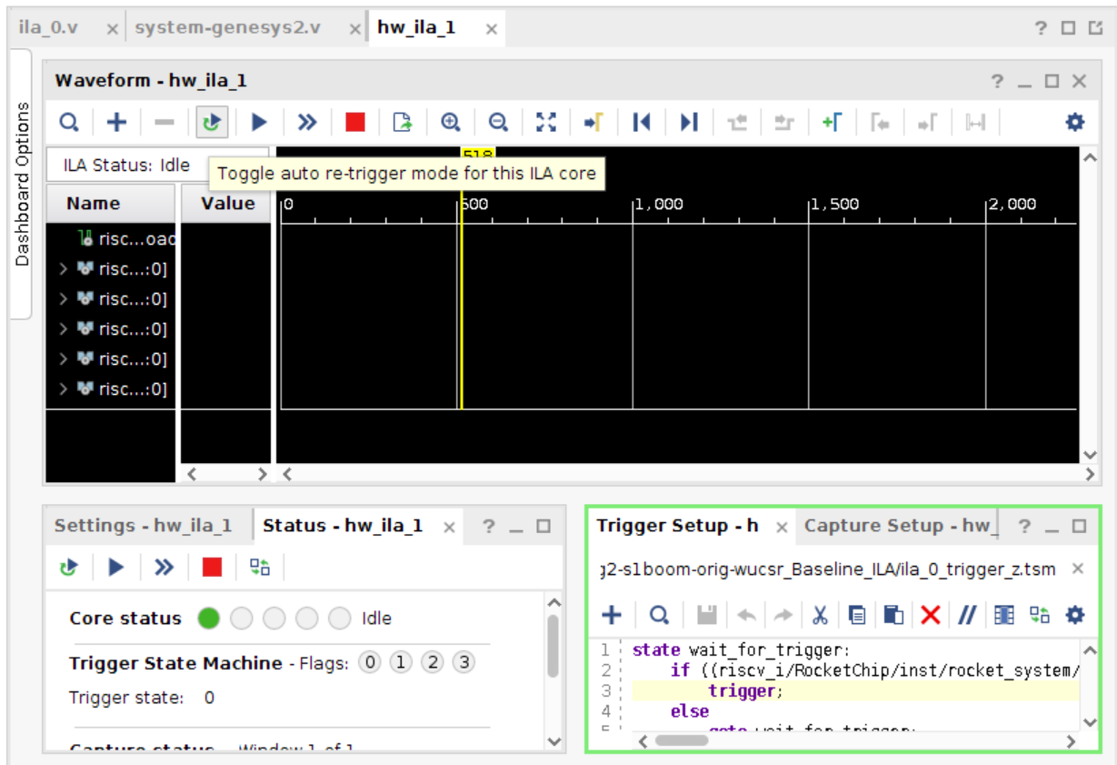
Integrated Logic Analyzer (ILA)
Now HARDWARE MANAGER window looks like this
Create a .tsm file to set up trigger conditions

Slide 17

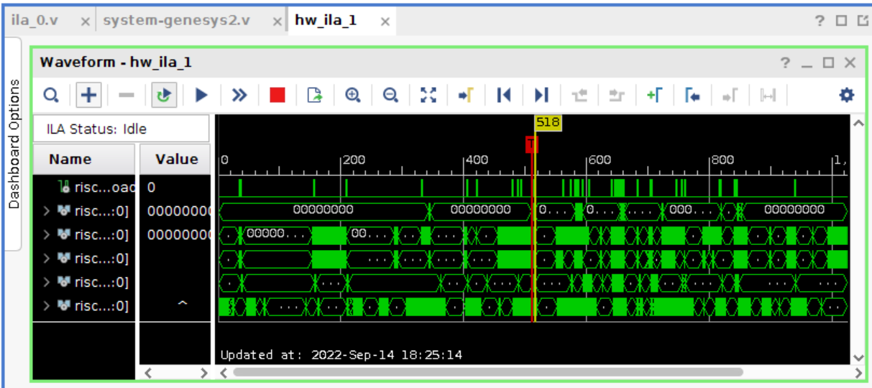
Integrated Logic Analyzer (ILA)
Check the option , then click , the waveform will be updated every time a triggering condition is met
For more details about ILA and programming .tsm trigger file, please check this video: https://youtu.be/_ljXMoGJ5iM

Slide 18
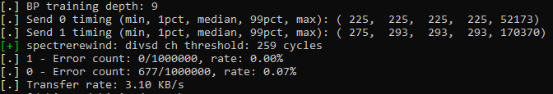
New microarchitectural attack replications on SonicBOOM
FDiv covert channel
Read the SpectreRewind paper at: https://arxiv.org/abs/2003.12208
To better understand the how FDiv covert channel works on x86, go to its github: https://github.com/CSL-KU/SpectreRewind-PoC
Port FDiv channel to SonicBOOM
Find the threshold determination code detect_spr.c in 463c server at: RISCV2022/Documents/fromZhiming/
Compile detect_spr.c in FPGA and run (refer to Section 2 of this tutorial)
You should see a hist.dat generated and the terminal output similar as:
If you see error rate is too high, rerun the executable

Slide 19
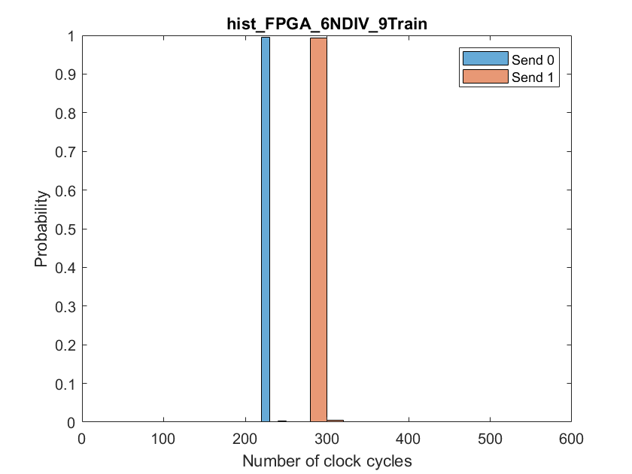
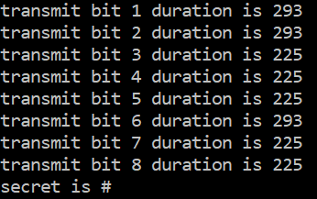
Port FDiv channel to SonicBOOM
Further verify the threshold
Plot hist.dat (can use the matlab code histogram_FPGA_z.m in 463c server at: RISCV2022/Documents/fromZhiming/)
Should see a clear threshold based on the plot
Transmit a secret byte using the FDiv channel
Find the FDiv channel source code FDiv_test.c in 463c server at: RISCV2022/Documents/fromZhiming/
Compile FDiv_test.c in FPGA and run
Should see secret byte is successfully recovered

Slide 20
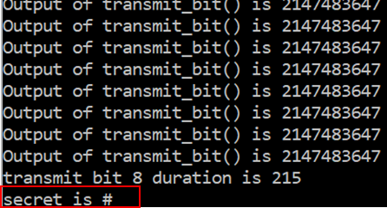
Port FDiv channel to SonicBOOM
Spectre V1 + FDiv on SonicBOOM
Combine Spectre V1 frontend with FDiv covert channel, the source code SpecV1_FDiv_withCond_V1.c can be found in 463c server at: RISCV2022/Documents/fromZhiming/
Compile and run, a secret byte should be recovered as:

Slide 21
New microarchitectural attack replications on SonicBOOM
Spectre V4 attack
Understand Spectre V4 basics at: https://www.cyberus-technology.de/posts/2018-05-22-intel-store-load-spectre-vulnerability.html
Github
My Spectre V4 code SpectreV4_06292022.c (not complete) is in 463c server at: RISCV2022/Documents/fromZhiming/

Slide 22
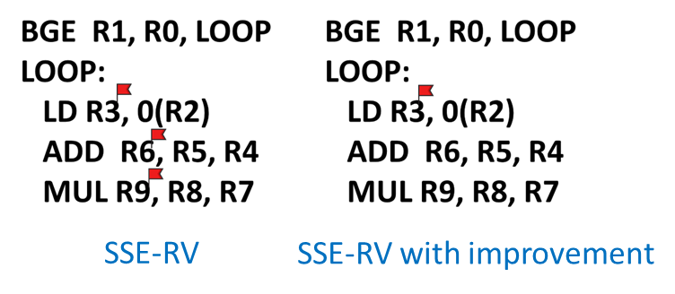
Improvement of SSE-RV
Read Majid’s SSE-RV paper to understand the original taint initialization scheme.
An “overtainting” issue is in Majid’s SSE-RV source code at /home/majid/unified_MajidSabbagh_PhD under SSE-RV/SonicBoom
In his code, all speculative instructions’ destination registers are tainted.
It is too aggressive because only speculative load instructions can steal secret from memory
One improvement is restricting the taint initialization only to speculative load instructions
Find the BOOM core with this improvement in 463c server at: RISCV2022/Documents/boomCores/boom_wLoadRestriction/

Slide 23
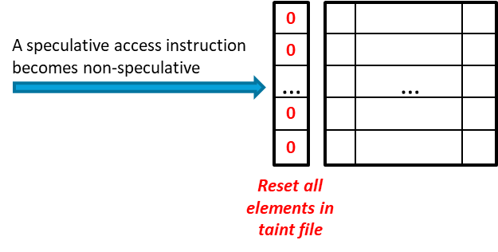
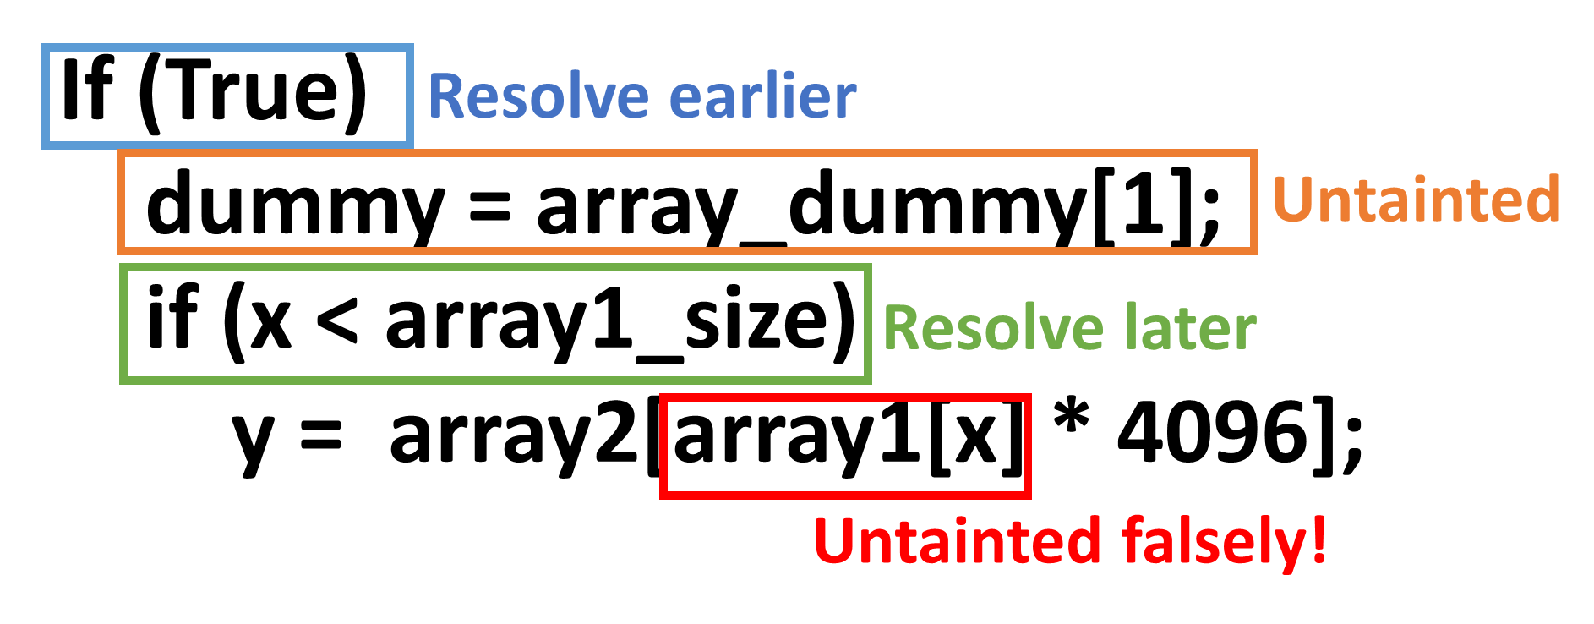
Improvement of SSE-RV
Read Majid’s SSE-RV paper to understand the original untainting scheme.
An “overuntainting” issue is SSE-RV untaints all registers when any speculative access instruction passes speculative status
Instructions remain speculative may be accidently marked as safe

Slide 24
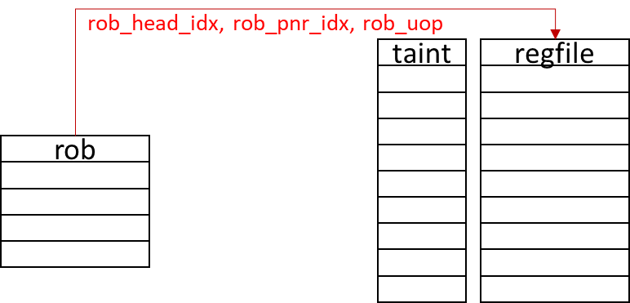
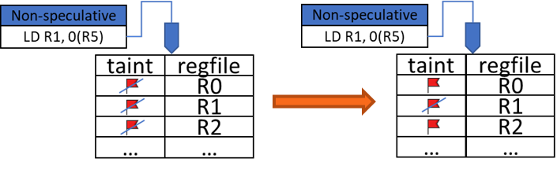
Improvement of SSE-RV
One improvement is we can now specifically untaint the destination registers of individual instructions
We build connections between reorder buffer (ROB) and register file
We check the speculative status for each in-flight instruction at runtime
Track the destination registers of instructions that passed speculative status and untaint them
Find the BOOM core with this improvement at: RISCV2022/Documents/boomCores/boom_newUntaint/

Slide 25
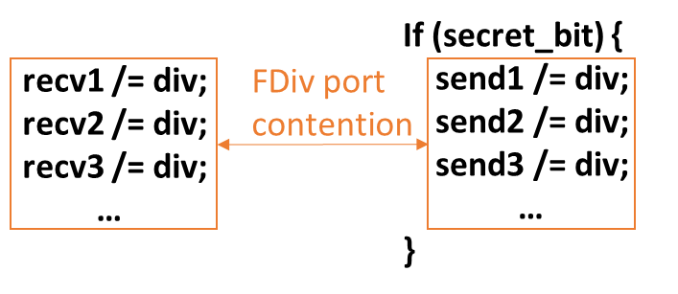
Extended SSE-RV
Extend the back end protection of SSE-RV
Current SSE-RV only blocks cache covert channel
Extended back end protection should be able to thwart port-contention channels
Current strategy: the contention is originated from a secret-dependent branch, such branch should be blocked from issuing
Specific implementation: rely on the taint-tracking of SSE-RV, a branch instruction should not be issued util its operands are untainted
Secret-dependent branch

Slide 26
Extended SSE-RV
The incomplete source code is in: RISCV2022/Documents/boomCores/boom_FDivCountermeasure/
Further extension: The strategy may also be applied to a “tainted load” to replace global memory fencing of SSE-RV to further improve performance
Refer to SSE-RV paper to understand the memory fence enforcement

